Slide 1
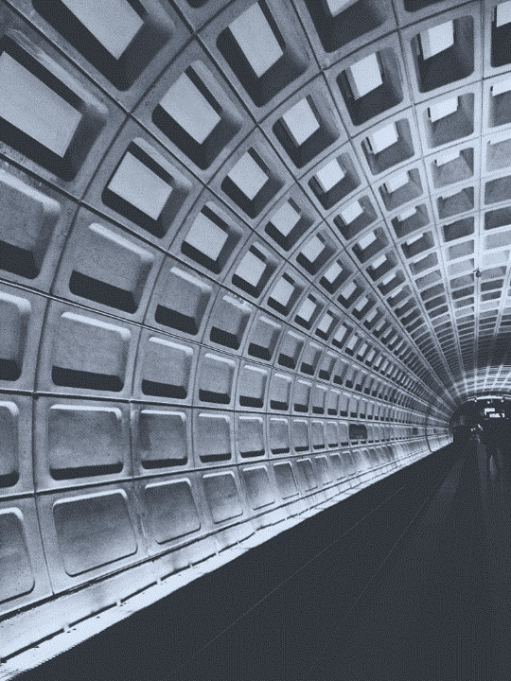

Right of Way
Work Report
Performance Management for Crews
Washington Metropolitan Area Transit Authority
January 2019

Slide 2
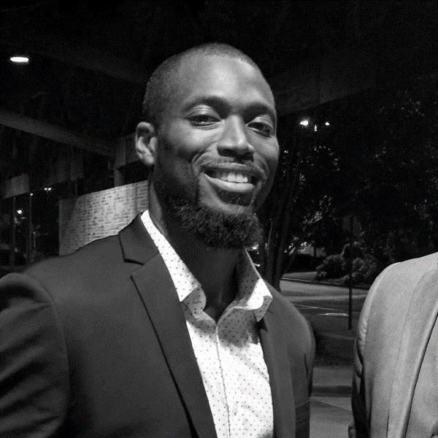



Nathan Williams
Manager
Maintenance of Way Engineering
Laura Moeini
Operations Analyst Strategic Initiatives
Katie Frost
Manager
Strategic Initiatives
Clifton Reed
Assistant Superintendent RAIL Track and Structures
WMATA Operations

Slide 3
Timeline for overnight work window on the rail:
Problem: A lot to do, little time to do it

Slide 4
What happens overnight on the rail…
Pre-work activities
Passenger trains clear the work zone
Third rail de-energized
Crews prepare and move into location
Safety checks
Post-work activities
Crews clean up and clear the work zone
Safety checks
Third rail re-energized
Passenger trains move into location
Time for work
11pm | Midnight | 1am | 2am | 3am | 4am | 5am
11:30p: Passenger trains stop running
5a: Passenger trains start running

Slide 5
We knew what the problem was, and started taking action to fix it
Challenge was, how were we going to effectively track progress over time?

Slide 6
The ROWWR (Right of Way Work Report) | Four innovative uses
1
2
Understand the current state and explore root causes of ROW work delays
Evaluate if a pilot was successful
3
4
Develop business cases for piloting specific projects (ideas to lengthen work time)
Shine a light on the efficient use of overnight ROW work, motivating and encouraging departments, teams, and individuals

Slide 7




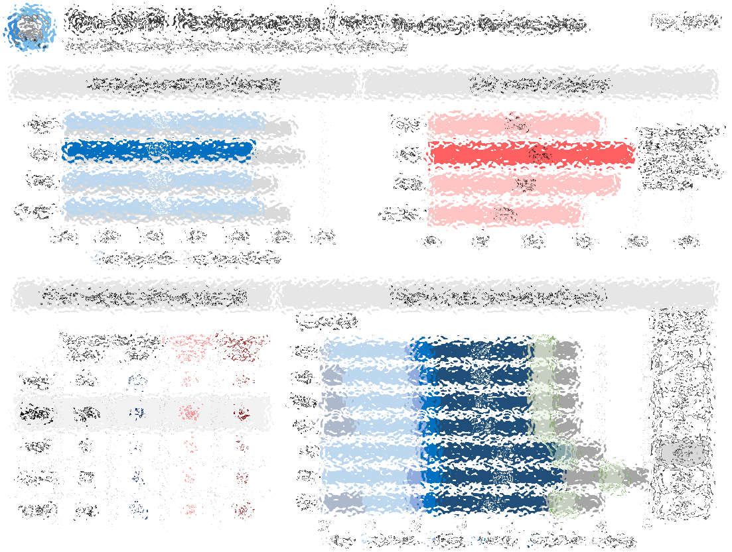
Starts here
Goes here
Affects here

Slide 8
The ROWWR helped identify opportunities for improvement and track progress for targeted projects
Through Metro’s efforts, we’re seeing results

Slide 9
Example 1
Developing business cases and evaluating pilots

Slide 10

1. Identified | 2. Partnered | 3. Piloted
ROWWR highlighted too many emergencies | Business owner developed a better process | Used the ROWWR to evaluate the pilot
!

Slide 11
Four innovative uses
Emergency requests
Dramatically fewer emergency requests

Slide 12
Example 2
Motivating/encouraging departments and effecting change

Slide 13






1. Partnered | 2. Introduced | 3. Influenced
Shared data possibilities with managers and asked: What’s most useful for YOUR teams? | A report that’s user-friendly and practical for ALL audiences | Managers used the custom ROWWR to monitor and encourage teams each month
Congrats to the Northeast Division for leading the way on this report!!! The challenge is out there…who will step up and knock them off?

Slide 14
Four innovative uses
Average work time per night
Significant improvement in average work time

Slide 15


